Slide 1
Research trends in studies of Concussion
Dominic Malcolm
Loughborough University

Slide 2
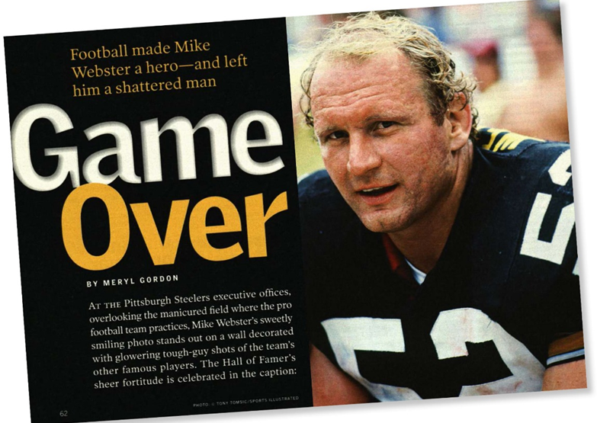
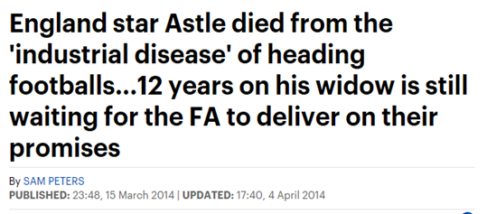
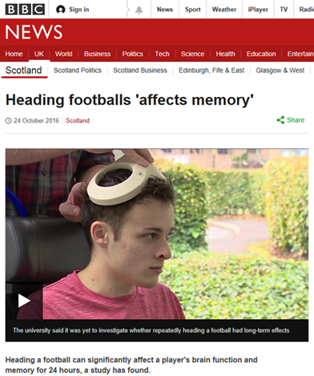
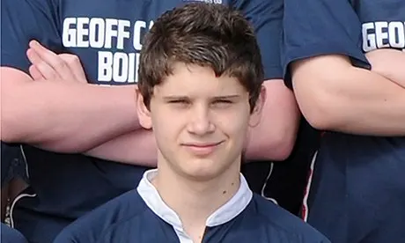
What’s the problem?
Head knocks and bell ringers
‘We don’t use the c-word’
Mike Webster and Jeff Astle (2002)
Second Impact Syndrome
  2006 Zachary Lystedt
  2011 Ben Robinson
Post concussive syndrome
  Longer to manifest
  Longer to resolve
Subconcussive impacts

Slide 3
What’s the real problem?
What we don’t know
what level of force causes concussion and/or longer-term problems
how to protect the brain from impacts
why people’s experiences are so diverse
how many is too many
What we do know
The culture of risk in sport and performance
Health vs performance in sports medicine
Athletes’ functional definition of injury
  “I was able to still do my job on the field and keep playing”

Slide 4
Approaches in Injury Prevention
Primary
Secondary
Tertiary

Slide 5
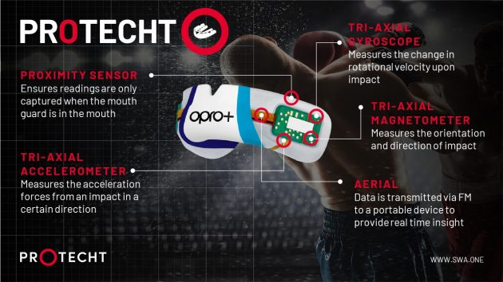
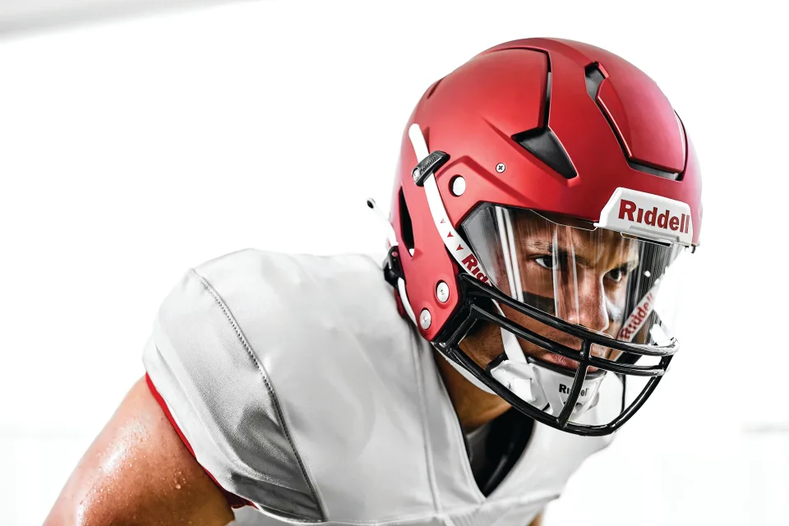
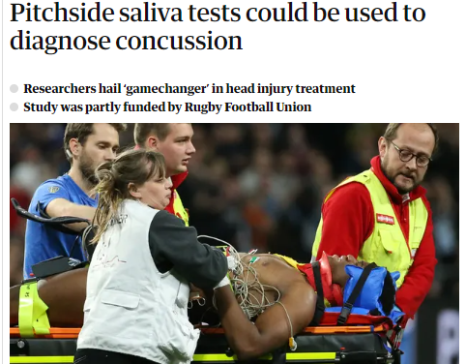
Primary Injury Prevention Strategies for Concussion in Sport
Rule changes
Monitoring impacts
Protective equipment
Secondary Injury Prevention Strategies for Concussion in Sport
‘Pitchside’ diagnostic testing
Return to Play Protocols

Slide 6
Education and Raising Awareness
Growing recognition of the role of sociocultural factors
  ‘Education is a mainstay of progress in this field … psychological and sociocultural factors in sport play a significant role in the uptake of any injury prevention strategy’ (McCrory et al. 2017)
The disconnect between knowledge, attitudes and behaviours
Calls for ‘cultural change’

Slide 7
Understanding Cultural Change
The dominance of psychological models:
‘the ways in which key audiences think and behave related to concussion … Changing the culture of concussion includes encouraging reporting of concussion, complying with appropriate concussion management plans, and other related shifts in social norms, attitudes, and behaviors around concussion to improve the health and safety of young athletes’ (Sarmiento et al. 2017: 790)
But:
Cultural change should be seen as a transitional, on-going process
In addition to psychologically-oriented facets of human behaviour (agency), cultural change should include cultural-structural aspects
Recognise that structural changes are more difficult to implement than psychological shifts

Slide 8
What cultural change might look like
Athletes
Increasing knowledge, changing attitudes and altering behaviours
- Co-production techniques to explore current failures
Providing greater stability of inclusion/income
- Keeping injured players involved
- Longer term contracts (for players, coaches, etc.)
Organisationally
Provision of healthcare at and for sport
- Identify responsibilities, provide training,
- Empower healthcare workers
- More rigorous appointment procedures
- Evaluate implementation
Socially
Wider recognition of the health costs of sport/exercise
Celebration of precaution rather than risk
Can cultural change be confined to brain injury only?

